Slide 1
Introduction to Databases Checkpoint
Mohamed Hedi Slatni

Slide 2
Summary
Define RDBMS
Define MySQL
Define PostgreSQL
Define SQL SERVER
Comparison between the three RDBMS

Slide 3
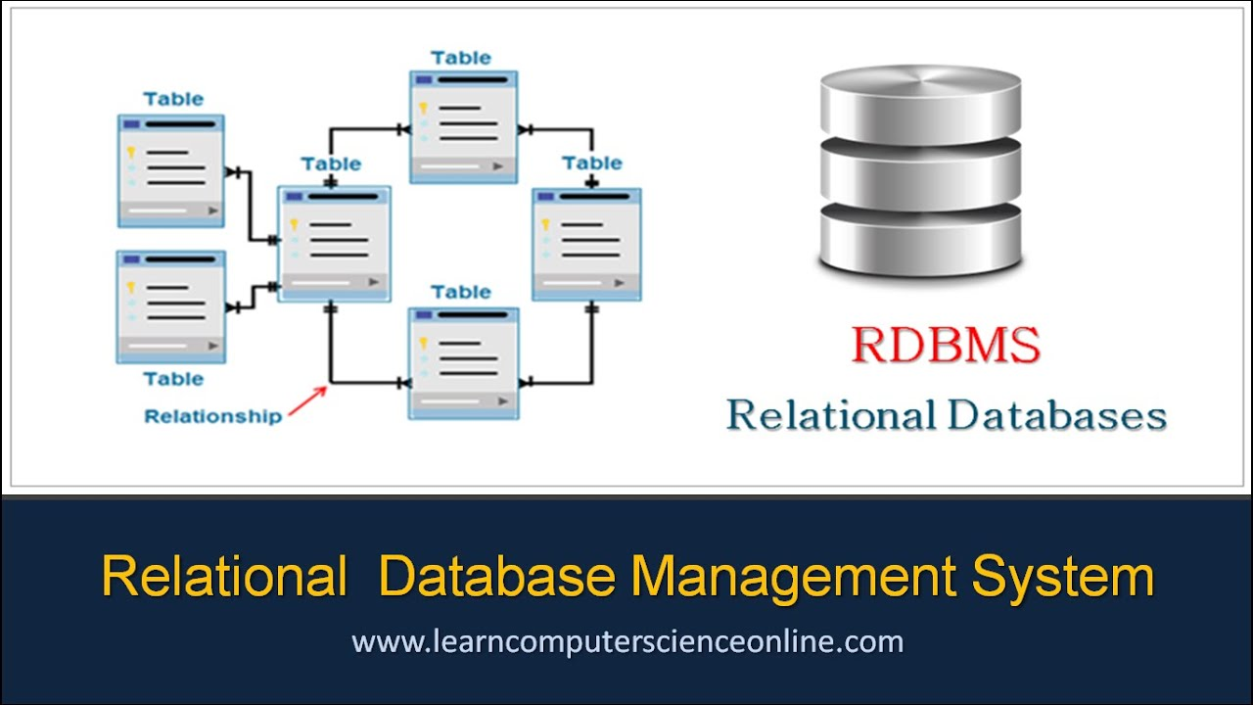
Define RDBMS
Relational Database Management Software (RDBMS) is a software system designed to allow the definition, creation, querying and updating of data stored in a relational database.
A few examples of RDBMS include:
Microsoft SQL Server
Microsoft Access
MYSQL
Oracle

Slide 4
2.Define MySQL
MySQL, pronounced either "My S-Q-L" or "My Sequel," is an open source relational database management system. It is based on the structure query language (SQL), which is used for adding, removing, and modifying information in the database. Standard SQL commands, such as ADD, DROP, INSERT, and UPDATE can be used with MySQL.
MySQL can be used for a variety of applications, but is most commonly found on Web servers. A website that uses MySQL may include Web pages that access information from a database. These pages are often referred to as "dynamic," meaning the content of each page is generated from a database as the page loads. Websites that use dynamic Web pages are often referred to as database-driven websites.
Many database-driven websites that use MySQL also use a Web scripting language like PHP to access information from the database. MySQL commands can be incorporated into the PHP code, allowing part or all of a Web page to be generated from database information. Because both MySQL and PHP are both open source (meaning they are free to download and use), the PHP/MySQL combination has become a popular choice for database-driven websites.

Slide 5
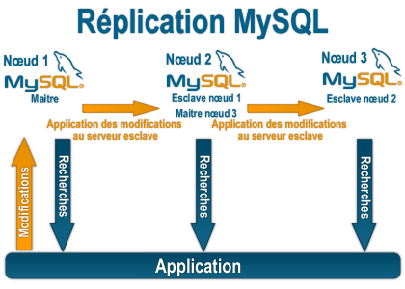

Slide 6
3.Define PostgreSQL
PostgreSQL is a powerful, open source object-relational database system that uses and extends the SQL language combined with many features that safely store and scale the most complicated data workloads. The origins of PostgreSQL date back to 1986 as part of the POSTGRES project at the University of California at Berkeley and has more than 30 years of active development on the core platform.
PostgreSQL has earned a strong reputation for its proven architecture, reliability, data integrity, robust feature set, extensibility, and the dedication of the open source community behind the software to consistently deliver performant and innovative solutions. PostgreSQL runs on all major operating systems, has been ACID-compliant since 2001, and has powerful add-ons such as the popular PostGIS geospatial database extender. It is no surprise that PostgreSQL has become the open source relational database of choice for many people and organisations.
Getting started with using PostgreSQL has never been easier - pick a project you want to build, and let PostgreSQL safely and robustly store your data.

Slide 7
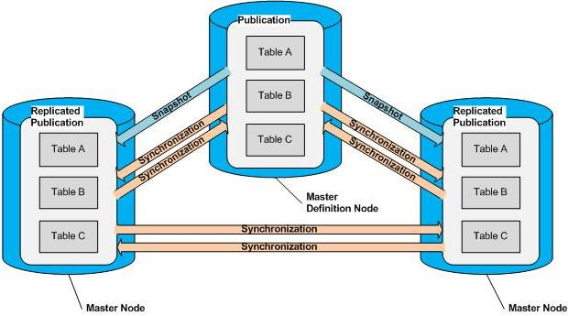

Slide 8
Define SQL SERVER
Microsoft SQL Server is a relational database management system (RDBMS) that supports a wide variety of transaction processing, business intelligence and analytics applications in corporate IT environments. Microsoft SQL Server is one of the three market-leading database technologies, along with Oracle Database and IBM's DB2.
Like other RDBMS software, Microsoft SQL Server is built on top of SQL, a standardized programming language that database administrators (DBAs) and other IT professionals use to manage databases and query the data they contain. SQL Server is tied to Transact-SQL (T-SQL), an implementation of SQL from Microsoft that adds a set of proprietary programming extensions to the standard language.

Slide 9
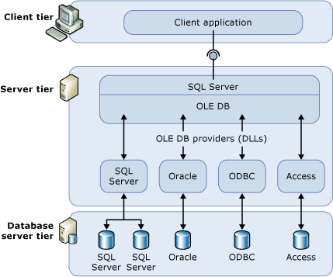

Slide 10
Comparison between the three RDBMS
PostgreSQL, MySQL, and SQLite use very similar syntax, with some notable differences highlighted below. Microsoft SQL Server has the greatest contrast in SQL syntax, as well as a wide variety of functions not available in other platforms. The table below highlights some examples of basic differences between SQL platforms.

Slide 11
